Slide 1
Keep C.A.L.M
And Check Contrast

Slide 2
Committed to Access
Virginia Tech is committed to equal opportunity in employment and education for individuals with disabilities and complies with the Americans with Disabilities Act, as amended, and Section 504 of the Rehabilitation Act of 1973. The C.A.L.M. campaign broadly promotes accessibility and supports compliance with VT Policy 7215 thereby creating a campus community with “equal access opportunity to electronic and information technology (EIT).” This is accomplished through adherence to Section 508 of the Rehabilitation Act and conformance with Web Content Accessibility Guidelines 2.0 AA (WCAG).

Slide 3
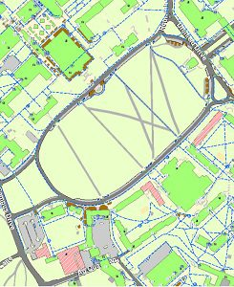
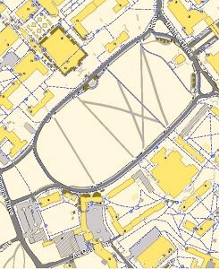

Why Check Contrast?
To effectively communicate!
8 percent of men and 0.5 percent of women with Northern European ancestry have the common form of red/green color blindness. (National Eye Institute)
Map of Drillfield with full color vision
Inability to distinguish between red & green
Inability to distinguish between any colors

Slide 4
Contrast Ratios
Must be 4.5:1 unless:
  Large-scale text, in which case 3:1 is okay
  Purely for decoration or is a part of something inactive
  Part of a logo
Some brand color combinations don’t work
  Web Burnt Orange on Chicago Maroon
  Burnt Orange on Yardline White
    Web Burnt Orange on Yardline White is okay though

Slide 5
Examples and non-examples
This is bad
Chicago Maroon text on Web Burnt Orange background
This is good
Yardline White text on Chicago Maroon background

Slide 6
Resources
Learn more at http://assist.vt.edu/calm/color-contrast
  Tools for:
    Verifying brand color combinations
    Checking other colors combinations
    Checking color contrast in Canvas
    Checking color contrast in MS Word
    Checking color contrast in MS PowerPoint
    Converting between color value formats
  Video tutorial

